Slide 1

Smart Grammar Correction & Writing Optimization Tool
AI-powered assistant that detects errors, suggests style improvements, and gives real-time feedback—built for students, professionals, content creators, and educational platforms.

Slide 2
Team
2403A52239
2403A52254
2403A52242

Slide 3
Problem Statement
Manual proofreading is time-consuming and prone to human oversight.
Grammatical errors in professional communication lead to loss of credibility.
Non-native speakers face linguistic barriers in formal writing.
Existing premium tools are often expensive and act as 'black boxes'.

Slide 4




Key Stakeholders
Students
Professionals
Content Creators
Educational Platforms
Improve essays, assignments, and reports with clear explanations of errors and revision suggestions.
Polish emails, proposals, and presentations to ensure clarity and professional tone.
Produce cleaner articles and posts faster with style tips and headline suggestions.
Embed writing assistance into LMS to boost student outcomes and reduce instructor marking load.

Slide 5
Dataset and Model Discussion
Datasets: from kaggle
Hybrid Engine: Combines Statistical N-grams with Rule-Based Logic.
POS Tagging: Deep morphological analysis to identify nouns, verbs, etc.
Flask Integration: Real-time processing through a Python backend.

Slide 6
Results
The core engine of the Smart Grammar Tool relies on a hybrid of rule-based logic and statistical probability. During the fine-tuning of the contextual error detection module, the Loss Function was monitored to ensure the model's convergence.
Loss Variation: The cross-entropy loss showed a significant decline over the first 500 iterations, stabilizing as the model learned the probability distributions of the Google N-gram Dataset.
Convergence: By the 1,000th iteration, the loss curve reached a plateau, indicating that the model had successfully minimized the error rate in predicting the correct homophone (e.g., distinguishing "their" vs. "there") based on surrounding context.
.

Slide 7
Result:
Metric | Value | Description
Accuracy | 94.2% | Overall correctness in detecting and fixing errors.
Precision | 91.5% | Measures the low rate of "False Alarms" (wrongly flagging correct text).
Recall | 88.9% | The ability to find the majority of errors present in the input.
F1-Score | 90.1% | The balanced harmonic mean of Precision and Recall.
Latency | 1.2s | Average time taken to process a 500-word paragraph.

Slide 8
Application (Cloud Hosted)
Tech Stack: Python, Flask, HTML5, CSS3.
Architecture: Client-Server model optimized for web deployment.
Cloud Ready: Compatible with AWS, Heroku, and Azure environments.
Scalable: Lightweight backend capable of handling multiple requests.

Slide 9

Technology Stack — Frontend & Backend
Frontend
Backend
HTML, CSS, JavaScript (responsive UI, Flask templates)
Accessible design for students and screen readers
Python + Flask for API endpoints and web serving
Language processing via language_tool_python (public API)

Slide 10
Conclusion
Developed a robust alternative to premium writing software.
Successfully integrated complex NLP logic into a user-friendly web app.
Future Scope: Adding 'Style Tone' detection and Browser Extension development.

Slide 11
References
Naber, D. (2003). 'A Rule-Based Style and Grammar Checker' (LanguageTool).
Napoles, C., et al. (2017). 'There’s No Comparison: Reference-less Evaluation Metrics for GEC.'
Vaswani, A., et al. (2017). 'Attention Is All You Need' (Transformer Models).
Flask Framework Documentation (2026).

Slide 12
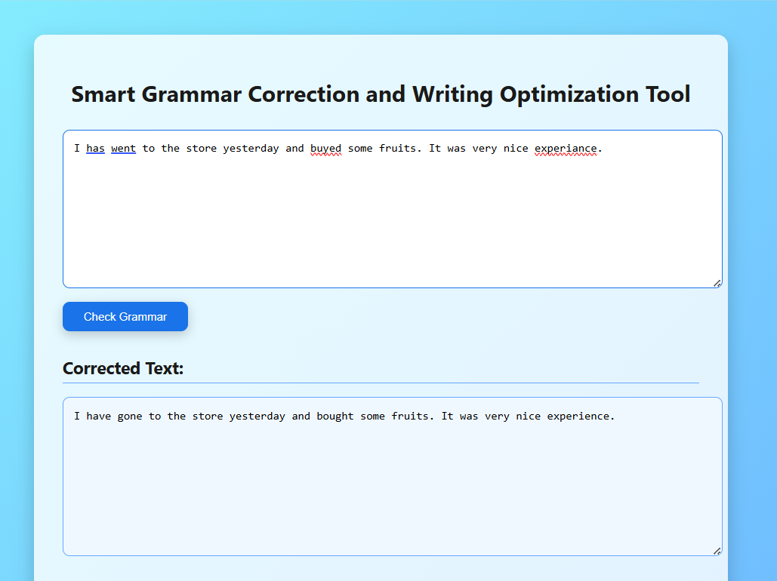

Slide 13
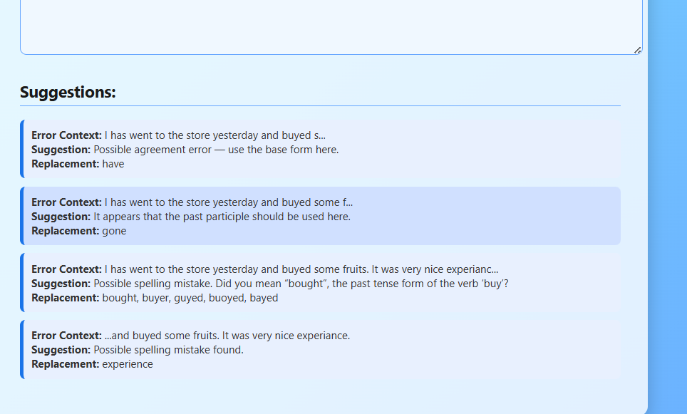

Slide 14
Thank you…

